Slide 1
Imitation Learning and Reinforcement Learning in Escape & Chase Games
Ruolin Qu
Shengdong Liu
Yunao Shen

Slide 2
Problem Statement
Reinforcement Learning and Imitation Learning in Multiple agent adversarial competition
Imperfect information game and sparse reward.
Strategy learning
Limited computer resources

Slide 3
Motivation and Application
Motivation
Many real-world applications require AI agents to compete and coordinate with other agents in complex environments. To achieve this goal, games become a challenge for AI research. There are some multi-agent reinforcement learning research to deal with imperfect information(AlphaStar), but it consume lots of data and computer resources and take about a decade to complete the approach. We wish to use Imitation learning and RL to deal with a smaller scale problem in an hide&escape games with limited resources and we also want to explore further for AI in an imperfect information game
Application
A good result to complete small scale problem with limited resources
Use imitation learning to teach agent with some obvious strategies
Encourage further work on imperfect information game.

Slide 4
Prior Work
Grandmaster level in StarCraft II using multi-agent reinforcement learning
First agent reach the highest league of human players in a widespread professional e-sport without simplification of the game.
Relies on imitation learning combined with reinforcement learning.
Consists of tens of thousands of time-steps and thousands of actions, observation includes all visible units and attributes. Takes about 50 days training to reach that goal.
Race difference,3 races of Starcraft might be able to consider as an imperfect information asymmetric game. They use 3 agents for each race and 3 main exploiter agents and six league exploiter agents.

Slide 5
Prior Work
Emergent Tool Use from Multi-Agent Interaction
https://openai.com/blog/emergent-tool-use/
2 kinds of Agents( seeker, hider) learn to use tools to create Shelter and break in in a simulated environment.
Relies on reinforcement learning and self-play. Doesn’t involved imitation learning.
The result is generated after hundreds of million training episodes.

Slide 6
Prior Work
Multi-Agent Generative Adversarial Imitation Learning
https://papers.nips.cc/paper/7975-multi-agent-generative-adversarial-imitation-learning
Generative Adversarial Imitation Learning(GAIL) can be used to imitate complex behaviors in high-dimensional environments with multiple cooperative or competing agents.
Imitate the demonstrations of a set of experts to learning parametrized policies.

Slide 7
Prior Work
Unity Machine Learning Tool Kit
https://unity3d.com/machine-learning
Unity provide an open-source ML platform that enables games and simulations to serve as environments for training intelligent agents. Our project are based on this platform.

Slide 8
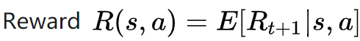
Challenges: Learning algorithm& model
Initial Appoarch: DRL(Deep Reinforcement):
Kownlege Base (Agent):
Action:
State:
Estimate the reward for each action(Q-Value)
Pick the action with the highest Q value
Markov Decision Process
In the state S, the state S(i+1)and the return R(i+1) after the action a are only related to the current state and action, and have nothing to do with the historical state

Slide 9
Reinforcement learning with sparse and delayed rewards
Setting one reward policy is not hard, but for multiple behaviors with complicated reward policy, the problem comes.
Actions may have long term benefit will not gain reward from the current state.

Slide 10
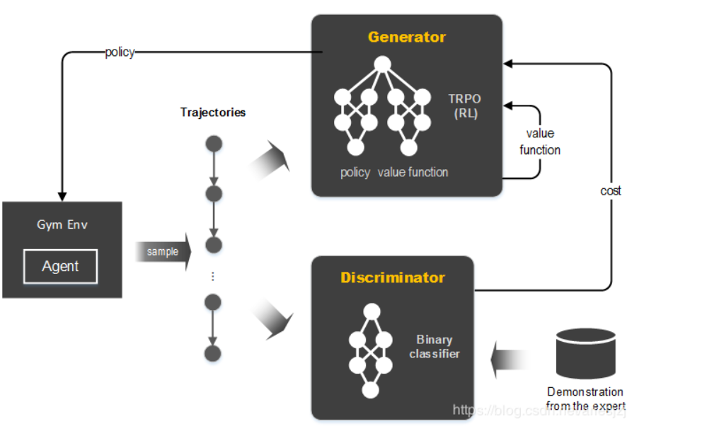
Proposed Solutions:
GAIL, or Generative Adversarial Imitation Learning, is an imitation learning algorithm that uses an adversarial approach.
Train a generative model G by having it confuse a discriminative classifier D.
The job of D is to distinguish between the distribution of data generated by G and the truedata distribution.
When D cannot distinguish data generated by G from the true data, then G has successfully matched the true data.

Slide 11
GAIL:( avoid explictly hand-coded reward)
In the training process, for each action the agent make, the discriminator produce a reward based on how similar the action is to the actions in the demo.
After getting the reward received from GAIL, we send it as one of the intrinsic reward signal to the reinforcement learning model. Then the agent would try to maximize the reward, thus encouraging the agent to mimic the behaviors in the demo.
As the agent making actions more and more similar to the demo actions, the discriminator also keeps training on those more similar actions. Thus the discriminator is becoming more and more accurate.

Slide 12
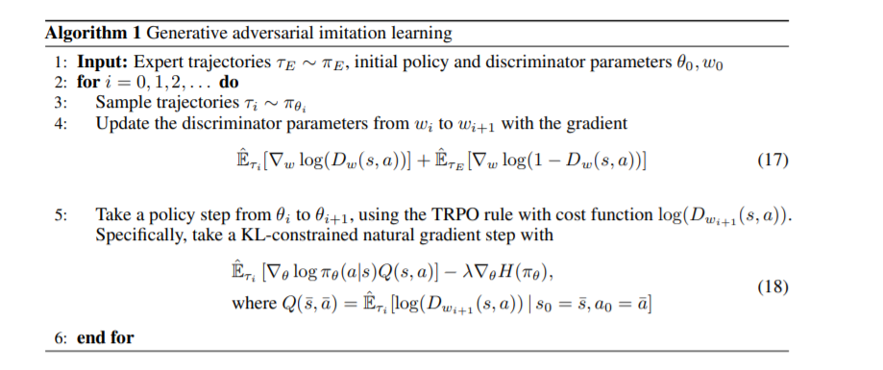

Slide 13
Reward Setting:
Extrinsic reward: the reward gained from environment.
Escapee: arriving win zone +1.
Chaser: catch the agent +1, times up +1
Extrinsic reward is triggered by event in environment.
Intrinsic reward: the reward gained from inside the agent.
In GAIL, it’s the reward of being similar to actions in demo. Intrinsic reward is given to the model by itself for actions that is beneficial for future goal.

Slide 14
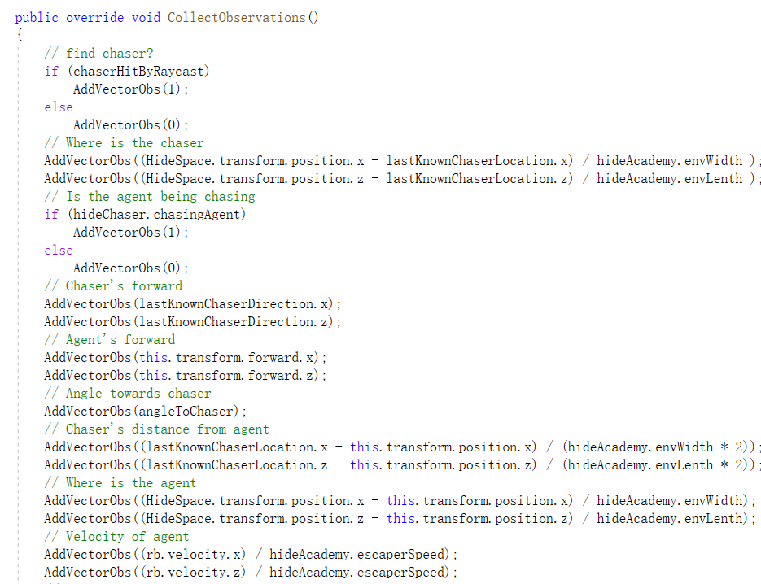
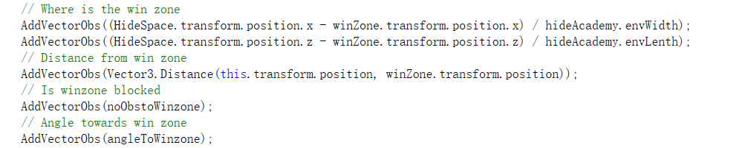
State Space for Escapee:
Where is chaser
Chaser's moving direction & distance
Being chased or not
Location, direction velocity itself
Winzon
Raycast(dectecting info e.g walls & agents)

Slide 15
State Space for Chaser
Position of the escaper
Whether escaper is being detected
Velocity & direction of escapee
Distance from escapee
Raycast(dectecting info e.g walls & agents)
Action Space for Agents:
Move Foward
Move Backword
Turn left
Turn right

Slide 16
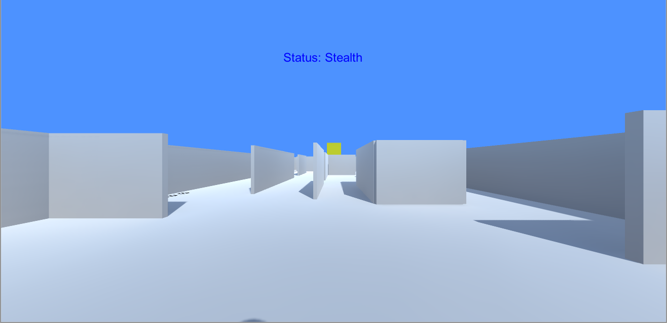
Demonstration Recording:FPP
First person cameras for both escaper and chaser.
A status to warn the escaper when being chased.
The escapee still knows where the win zone is.
Demos contains the info sequence including observation, action, reward

Slide 17
Curriculum Learning
Another challenges in our project is that the agents need to learn very complicated policies, so curriculum learning could help boost training. The core concept of curriculum learning is starting from simpler task, gradually increase the difficulty, until the agent can complete the hard task that requires lots of training for initial agent.
In our project, for both escapee and chaser, we start training them in easier circumstance, then train them in hard circumstance. There are two difficulty factors we could use in our project:
Agent’s speed
Opponent agent strength

Slide 18
Training Environment
The training playground is a rectangle maze contains an escapee agent, a chaser agent and a win zone.
The escapee agent’s target is to reach the win zone in the limited time while avoiding the chaser.
The chaser agent’s target is to catch the escapee before it reaches the win zone.
Once the escapee reaches win zone or get caught, round is over, and the training playground would reset.

Slide 19
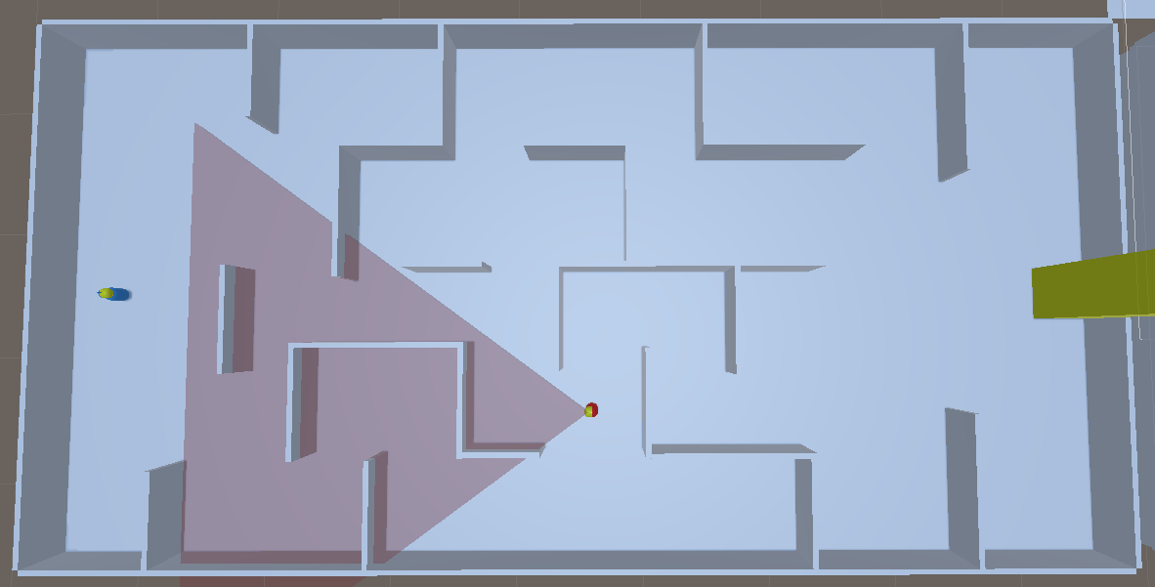
Training Environment
Blue agent: escapee (yellow mask indicates the direction)
Red agent: chaser (yellow mask indicates the direction)
Yellow location: win zone

Slide 20
Training Environment
The training environment is a randomly generated playground. It would reset in the beginning of each round.
When resets:
All the walls are deactivated. Then each wall(except the boundaries) in the playground has a probability of 75% to be activated.
The escapee would randomly spawn at one of the four spawn locations.
The chaser would randomly spawn at one of the four spawn locations.

Slide 21
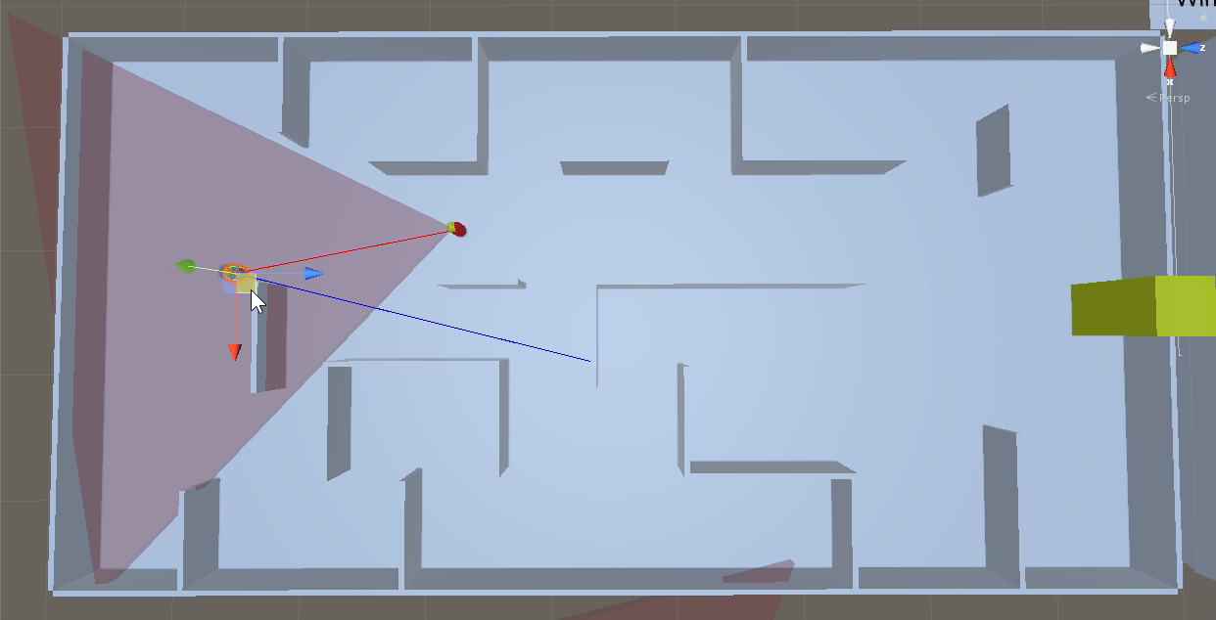
Training Environment

Slide 22
Training Environment
Why randomly generated environment instead of fixed environment?
Prevent agents from remembering the whole playground, thus avoid overfitting on given playground.
Encourage the agents to learn different strategies based more on its situations instead of brutally solve the maze with location information.

Slide 23
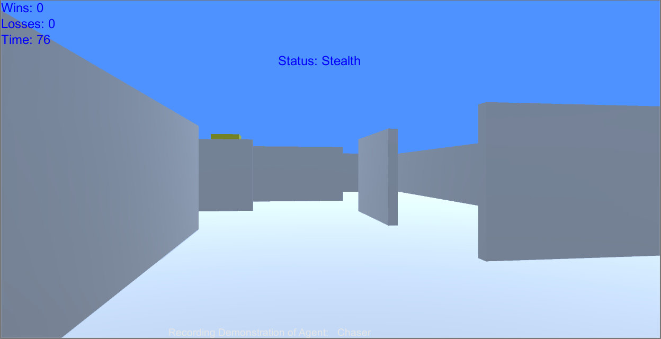
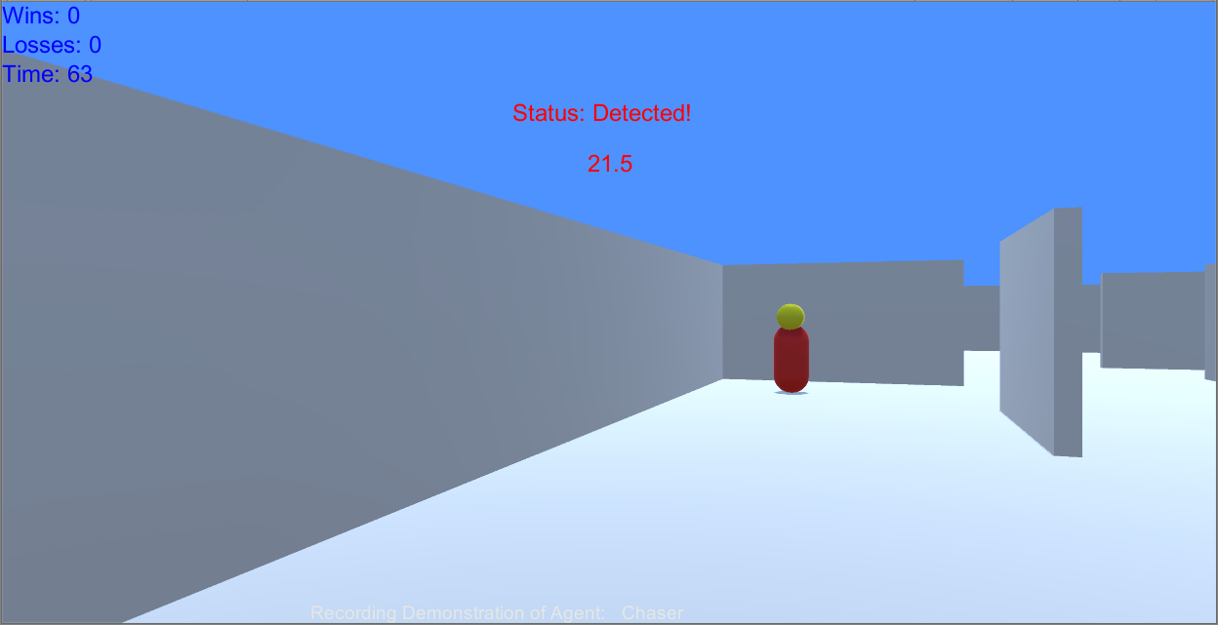
Escapee Agents
The escapee agent and chaser agent are both in first person perspective(FPP).
On the top left of the screen, it shows the wins and losses of agent and the remaining time of current round.
In the central of the screen it shows the status of the agent (stealth or detected). When detected, it also shows the distance from chaser.

Slide 24
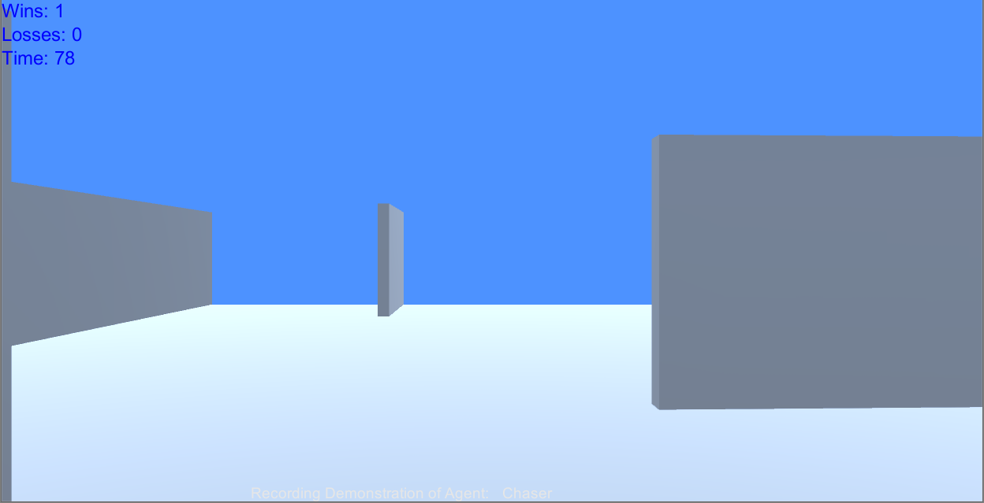
Chaser Agents
On the top left of the screen, it shows the wins and losses of agent and the remaining time of current round.
Different from escapee, the chaser has limit on its viewing distance. It could not see objects further than that distance.

Slide 25
Script-driven Chaser Agent
As this is an adversarial game, we need a script-driven chaser agent to get started with. The script-driven chaser would randomly patrol between six waypoints. Once it find escapee, it would always chase to the last location it detect escapee at. If it reaches the last seen location but loss track of escapee, it starts patrolling again.

Slide 26
Alternately Learning Structure
Alternately training escapee and chaser, so the agents would face the opponent that is becoming stronger and stronger.
With curriculum training, the agents would have harder and harder conditions. In our project, we set chaser’s speed as difficulty.

Slide 27
Alternately Learning Structure
Training Structure:
Training Section | Train_1 | Train_2 | Train_3 | Train_4 | Train_5
Training Parameters
Escapee Speed | 2.0 | 2.0 | 2.0 | 2.0 | 2.0
Chaser Speed | 2.0 | 2.5 | 2.25 | 2.25 | 2.5
Training Target
Training Model | Escapee | ChaserEasy | EscapeeEasy | ChaserHard | EscapeeHard
Against Model | ScriptChaser | EscapeeBasic | ChaserEasy | EscapeeEasy | ChaserHard

Slide 28
Training 1
To get the first AI agent, we train the basic escapee based on the script-driven chaser.
We set the agents speed the same to help boost training.
We record 5 demos as escapee playing against ScriptChaser.
Training Section | Train_1 | …
Training Parameters
Escapee Speed | 2.0 | …
Chaser Speed | 2.0 | …
Training Target
Training Model | EscapeeBasic | …
Against Model | ScriptChaser | …

Slide 29
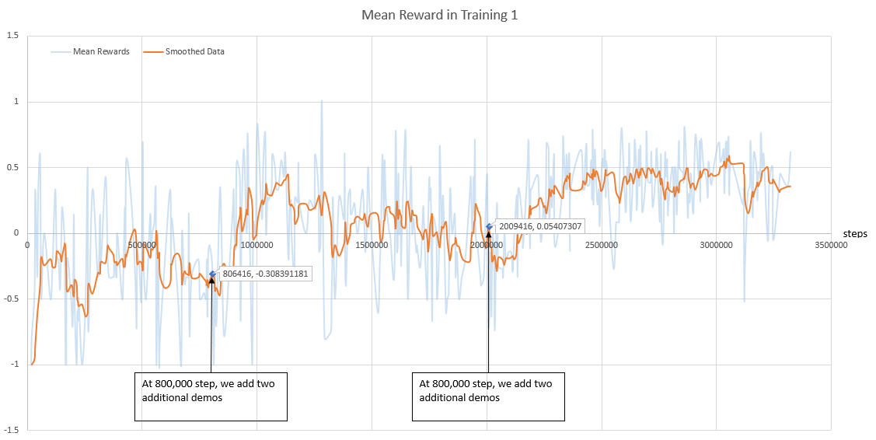
Training 1
After about 3,300,000 steps we get the AI escapee agent: EscapeeBasic
We test EscapeeBasic for 1000 rounds, the win rates is 32.4%

Slide 30
Training 2
We train the first AI chaser based on EscapeeBasic.
The first time we train chaser, we set it speed to 2.5 which would be easy for chaser to learn.
We record 5 demos as chaser playing against EscapeeBasic.
Training Section | Train_1 | Train_2
Training Parameters
Escapee Speed | 2.0 | 2.0
Chaser Speed | 2.0 | 2.5
Training Target
Training Model | EscapeeBasic | ChaserEasy
Against Model | ScriptChaser | EscapeeBasic

Slide 31
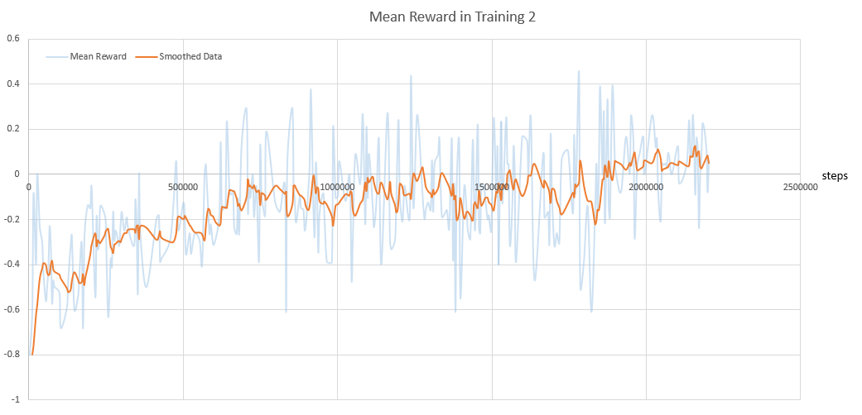
Training 2
After about 2,200,000 steps we get the AI chaser agent: ChaserEasy
We test ChaserEasy for 1000 rounds, the win rates is 55.7%

Slide 32
Training 3
Continue with EscapeeBasic, We train the escapee further against ChaserEasy.
This is the first training section for escapee to against AI chaser, so we set chaser speed lower to boost training.
We record 4 demos as escapee playing against ChaserEasy
Training Section | Train_2 | Train_3
Training Parameters
Escapee Speed | 2.0 | 2.0
Chaser Speed | 2.5 | 2.25
Training Target
Training Model | ChaserEasy | EscapeeEasy
Against Model | EscapeeBasic | ChaserEasy

Slide 33
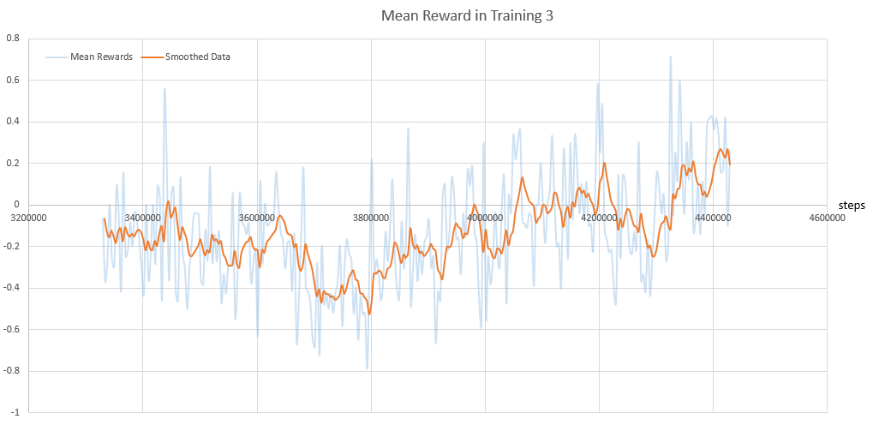
Training 3
After about 1,100,000 more steps we get EscapeeEasy trained from EscapeeBasic.
We test EscapeeEasy for 1000 rounds, the win rates is 65.8%

Slide 34
Training 4
Continue with ChaserEasy, We train the chaser further against EscapeeEasy.
Comparing with Train_2 (last time we train chaser) the chaser agent will face harder conditions:
Lower agent speed.
Stronger opponent(better trained agent)
We record 5 demos as chaser playing against EscapeeEasy.
Training Section | Train_2 | Train_4
Training Parameters
Escapee Speed | 2.0 | 2.0
Chaser Speed | 2.5 | 2.25
Training Target
Training Model | ChaserEasy | ChaserHard
Against Model | EscapeeBasic | EscapeeEasy

Slide 35
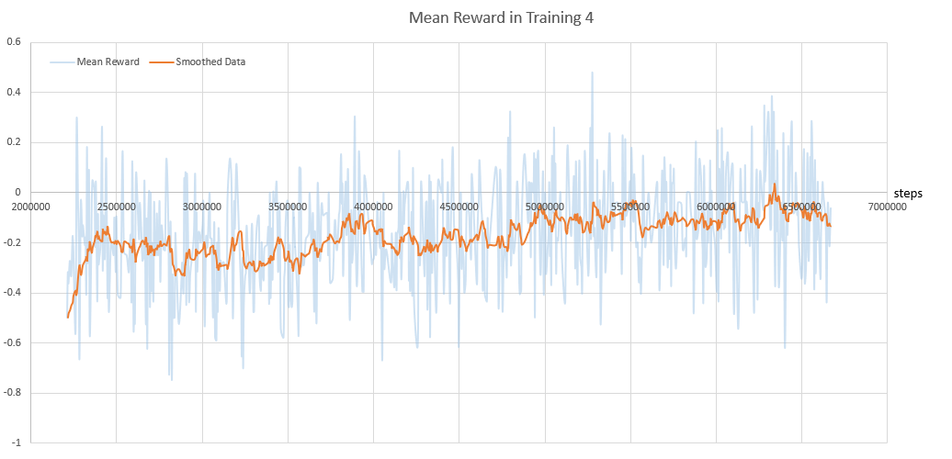
Training 4
After about 4,400,000 more steps we get ChaserHard trained from ChaserEasy.
We test ChaserHard for 1000 rounds, the win rates is 50.7%

Slide 36
Training 5
Continue with EscapeeEasy, We train the escapee further against ChaserHard.
Comparing with Train_3 (last time we train escapee) the escapee agent will face harder conditions:
Higher opponent speed.
Stronger opponent(better trained agent)
We record 4 demos as escapee playing against ChaserHard.
Training Section | Train_3 | Train_5
Training Parameters
Escapee Speed | 2.0 | 2.0
Chaser Speed | 2.25 | 2.5
Training Target
Training Model | EscapeeEasy | EscapeeHard
Against Model | ChaserEasy | ChaserHard

Slide 37
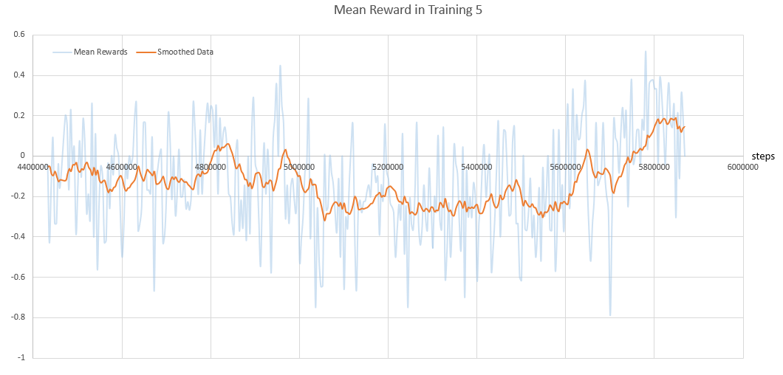
Training 5
After about 1,600,000 more steps Now we get EscapeeHard trained from EscapeeEasy.
We test EscapeeHard for 1000 rounds, the win rates is 46.6%

Slide 38
Win Rates of All Training Sections
In all 5 training sections, we test the win rates for each agent.
Training Section | Train_1 | Train_2 | Train_3 | Train_4 | Train_5
Training Parameters
Escapee Speed | 2.0 | 2.0 | 2.0 | 2.0 | 2.0
Chaser Speed | 2.0 | 2.5 | 2.25 | 2.25 | 2.5
Training Target
Training Model | Escapee | ChaserEasy | EscapeeEasy | ChaserHard | EscapeeHard
Against Model | ScriptChaser | EscapeeBasic | ChaserEasy | EscapeeEasy | ChaserHard
Win Rates After Training
Escapee | 32.4% | 44.3% | 65.8% | 49.3% | 46.6%
Chaser | 67.6% | 55.7% | 34.2% | 50.7% | 53.4%

Slide 39
Improvements Between Training Sections
ChaserHard is trained from ChaserEasy.
Under same circumstance:
Same speed for both agents
Same opponent agent
The win rate of escapee raise from 34.2% to 50.7%.
Training Section | Train_3 | Train_4
Training Parameters
Escapee Speed | 2.0 | 2.0
Chaser Speed | 2.25 | 2.25
Training Target
Training Model | EscapeeEasy | ChaserHard
Against Model | ChaserEasy | EscapeeEasy
ChaserWinRate | 34.2% | 50.7%

Slide 40
Improvements Between Training Sections
Training Section | Train_4 | Train_5 | Test Group
Training Parameters
Escapee Speed | 2.0 | 2.0 | 2.0
Chaser Speed | 2.25 | 2.25 | 2.25
Training Target
Training Model | ChaserHard | EscapeeHard | EscapeeHard
Against Model | EscapeeEasy | ChaserHard | ChaserHard
EscapeeWinRate | 49.3% | 46.6% | 52.9%
EscapeeHard is trained from EscapeeEasy.
In both sections, the escapee is facing the same opponent: ChaserHard.
But the agents speed is different. So we add a test group to keep same circumstance.
The win rate of escapee raise from 49.3% to 52.9%.

Slide 41
Results
We totally spend about 5,800,000 steps on escapee and 6,600,000 steps on chaser.
According to previous slides, both escapee and chaser agents are getting stronger as our learning sections continue. So the alternately learning structure works good in our project.
EscapeeHard and ChaserHard are our project’s latest training result. We record some video clips to show the training results.

Slide 42
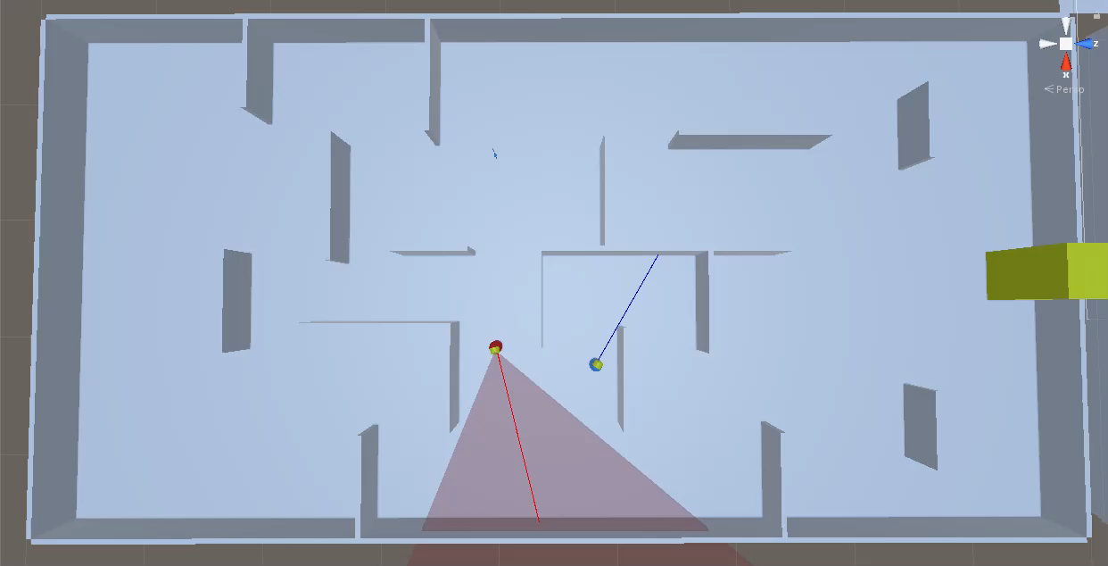
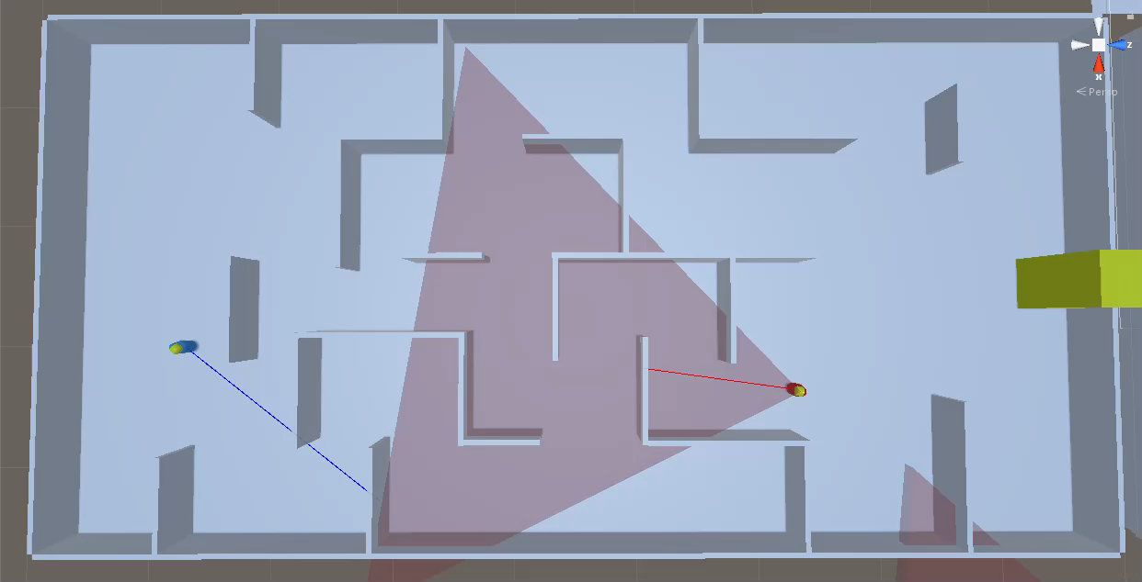
Handling Complex Environment
Escapee handles s-shaped path.
Chaser handles s-shaped path.

Slide 43
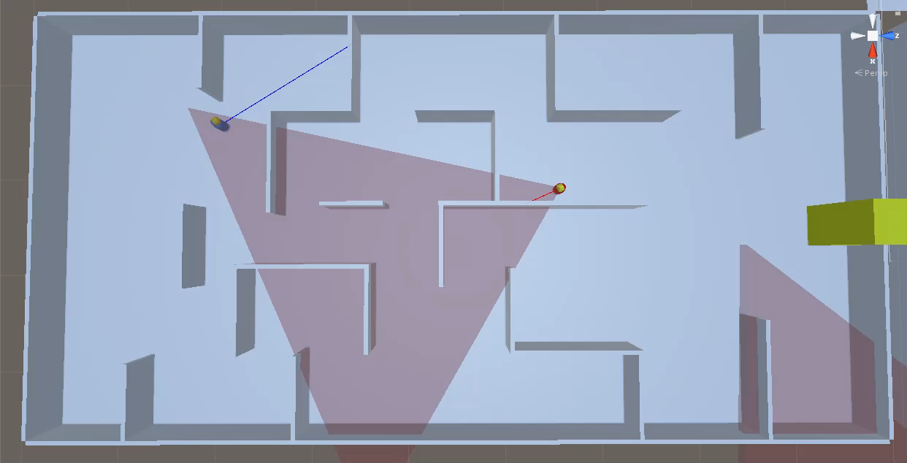
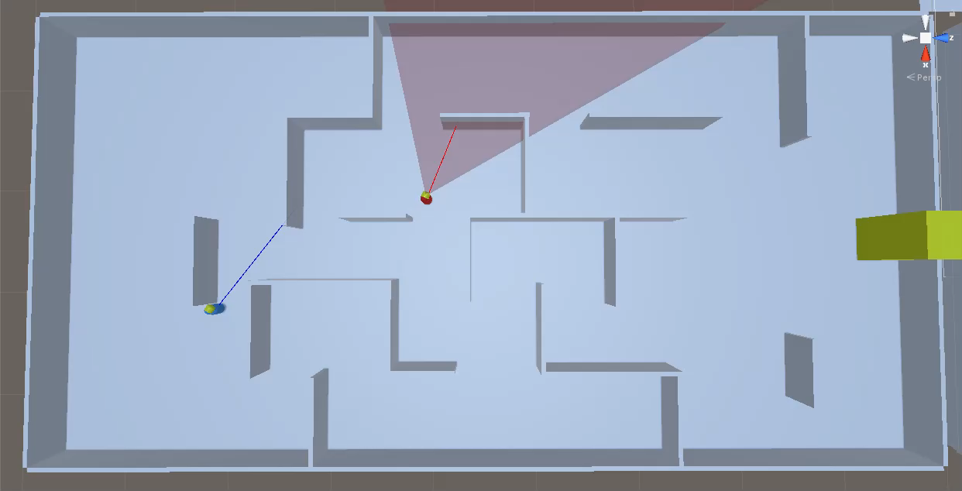
Handling Complex Environment
Escapee handles dead end.
Chaser handles dead end.

Slide 44
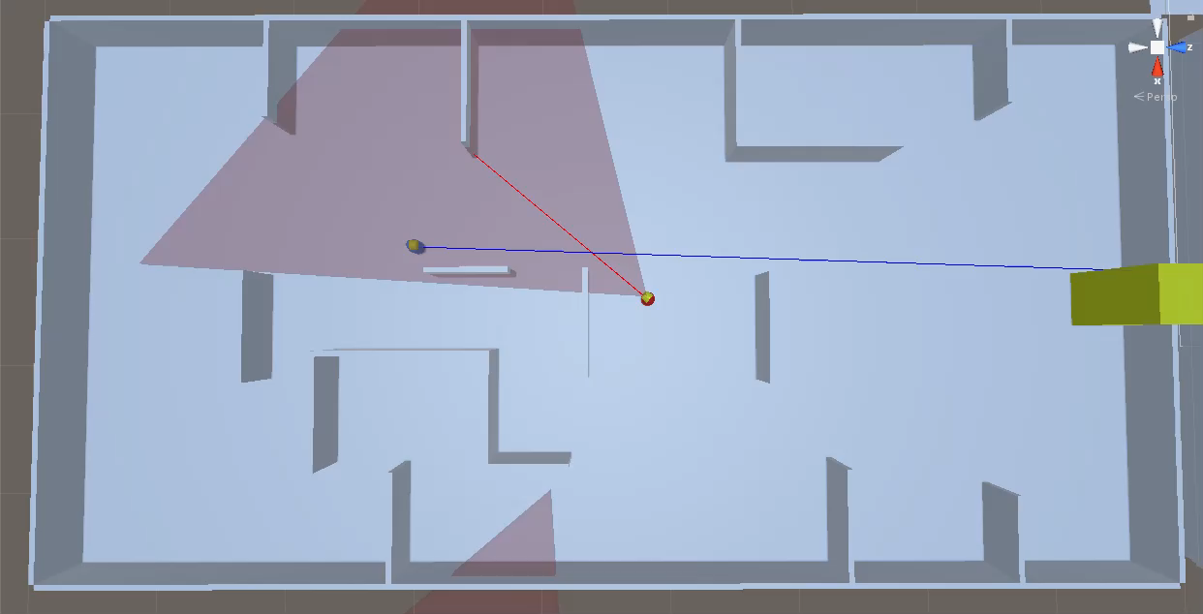
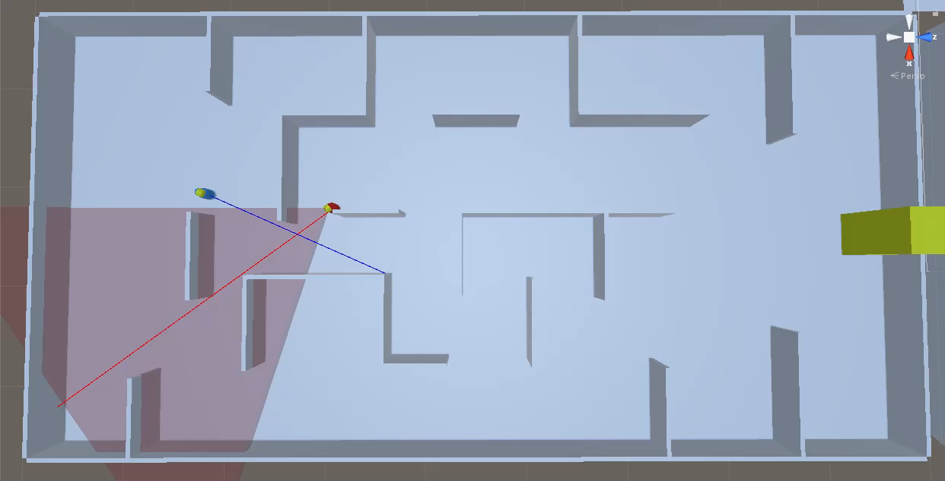
Strategies Escapee Learned
Escapee learns to avoid chaser.
Further, escapee learns to decide when to avoid.

Slide 45
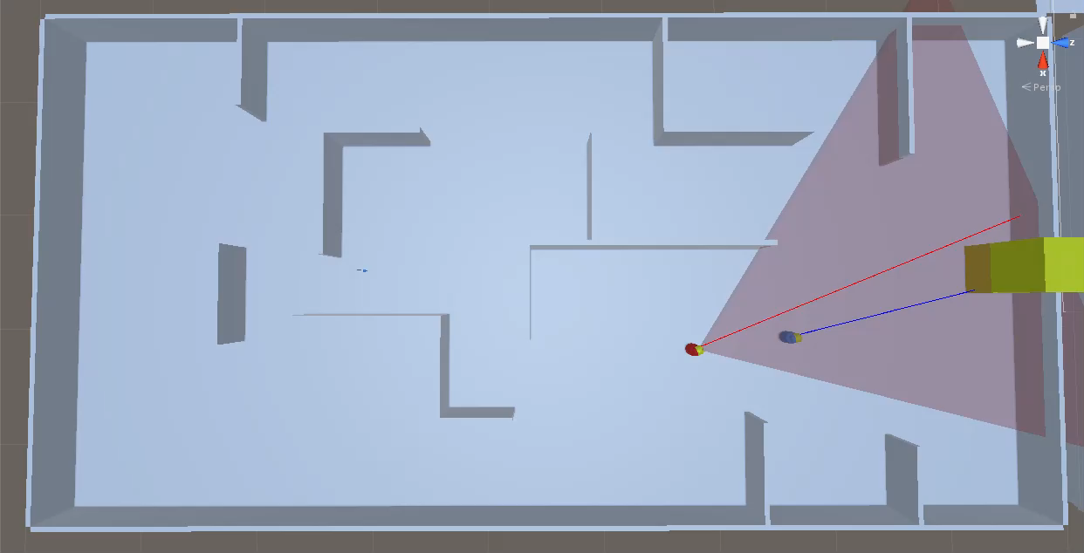
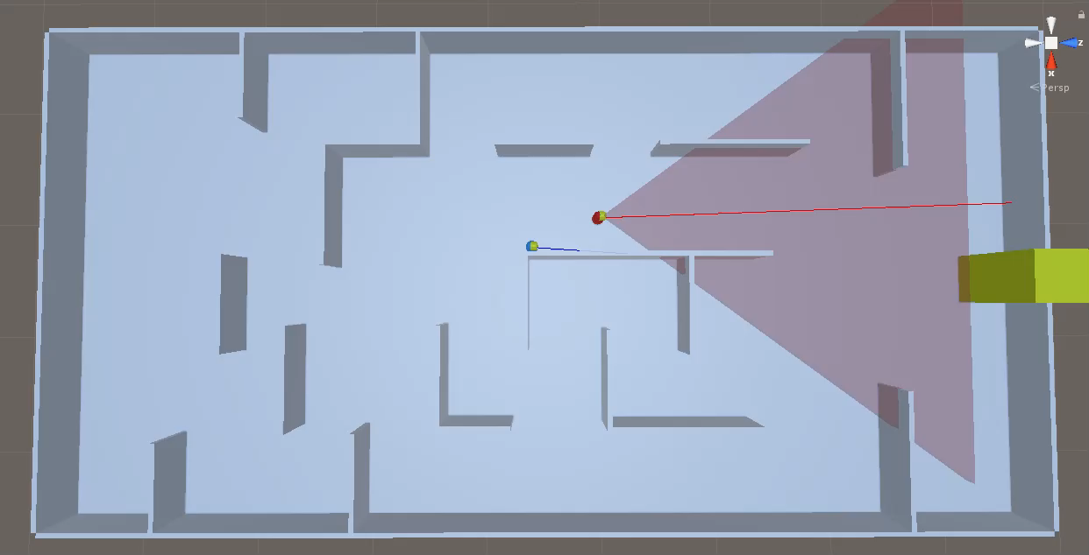
Strategies Escapee Learned
Escapee learns to rush to win zone when chaser is behind.
Escapee learns to sneak behind chaser.

Slide 46
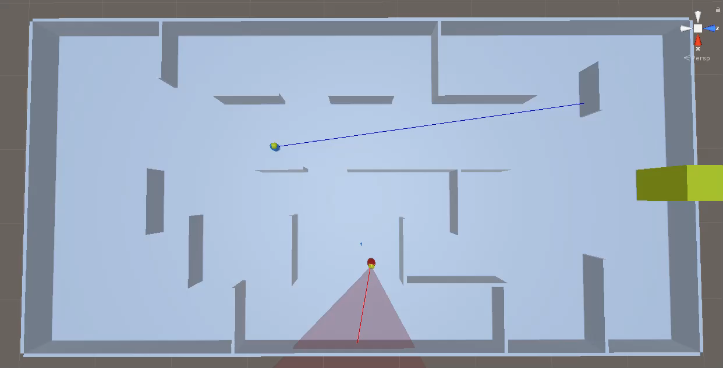
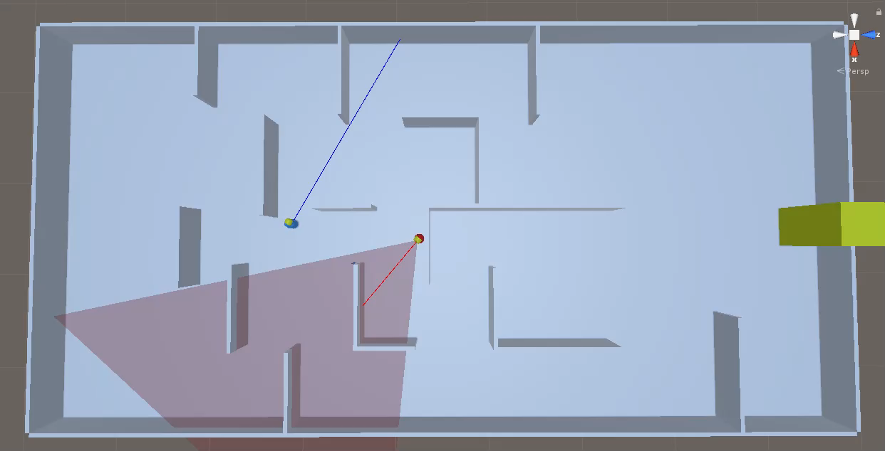
Strategies Chaser Learned
Chaser learns to investigate the last seen escapee location
Further, chaser learns to remember the moving direction of escapee

Slide 47
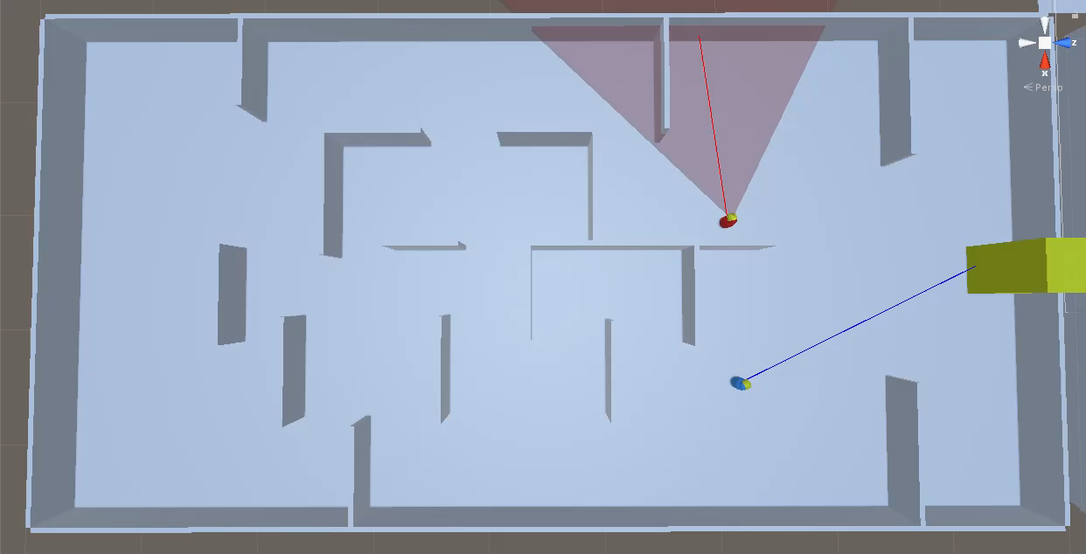
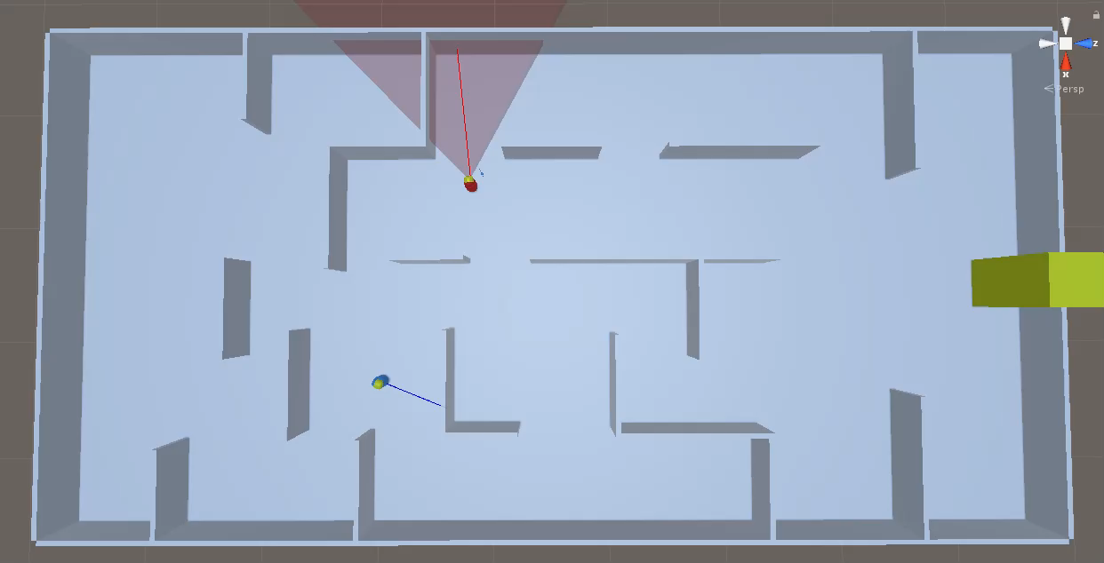
Strategies Chaser Learned
Chaser learns to intercept the estimate route of escapee
Further, chaser learns to predict the route of escapee even with just a glance.

Slide 48
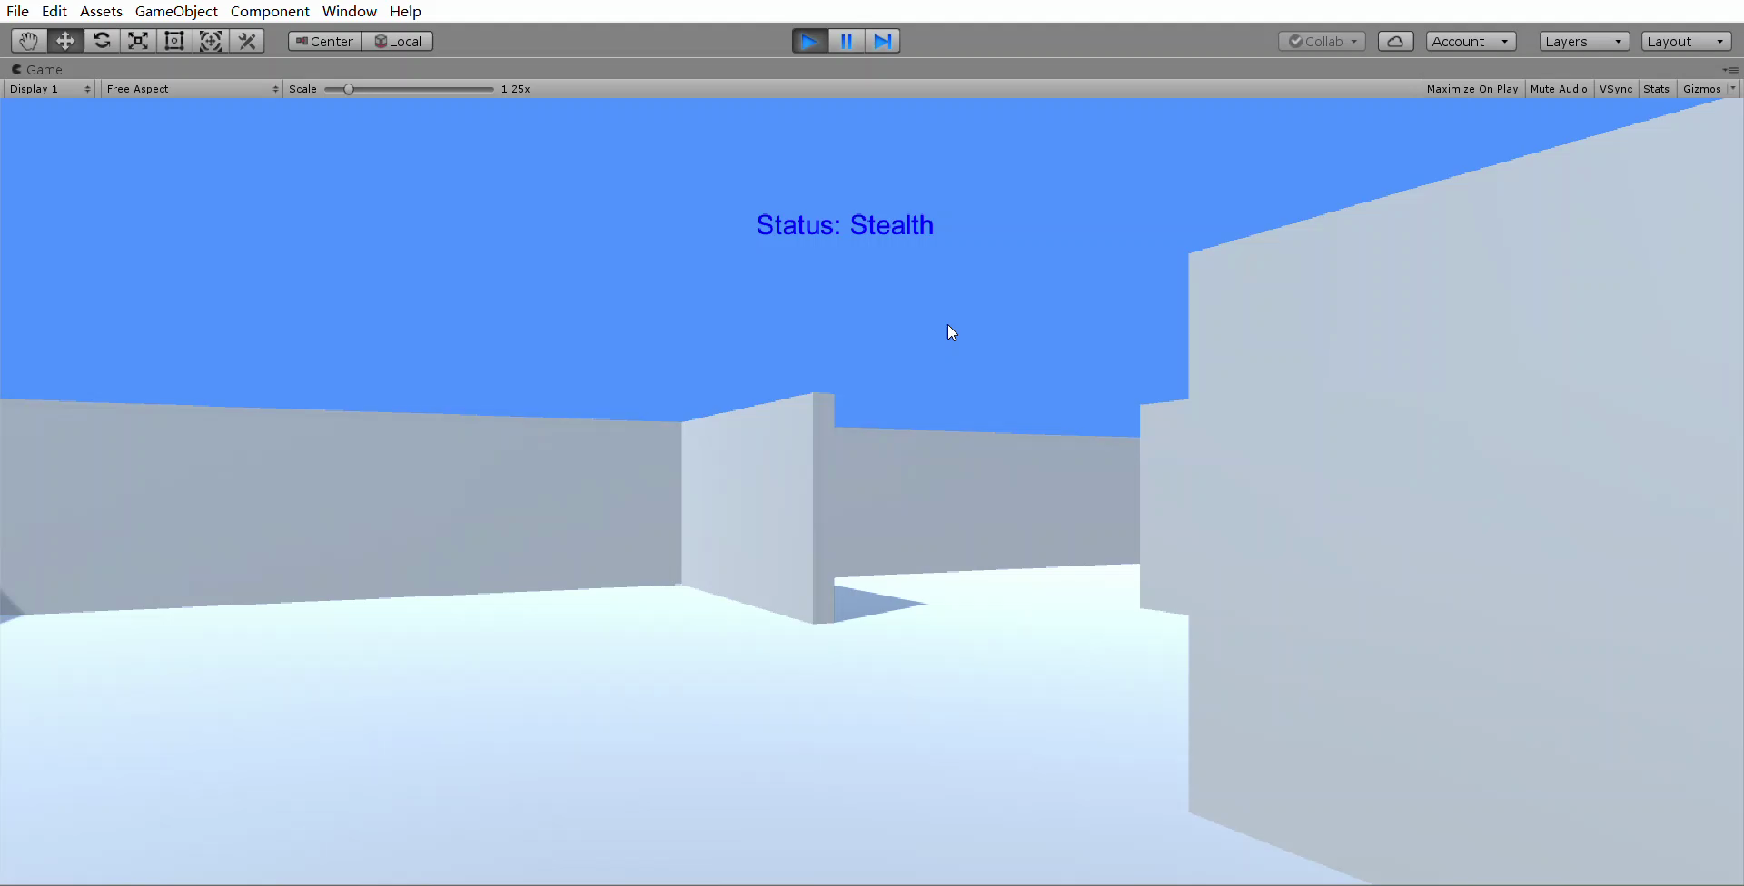
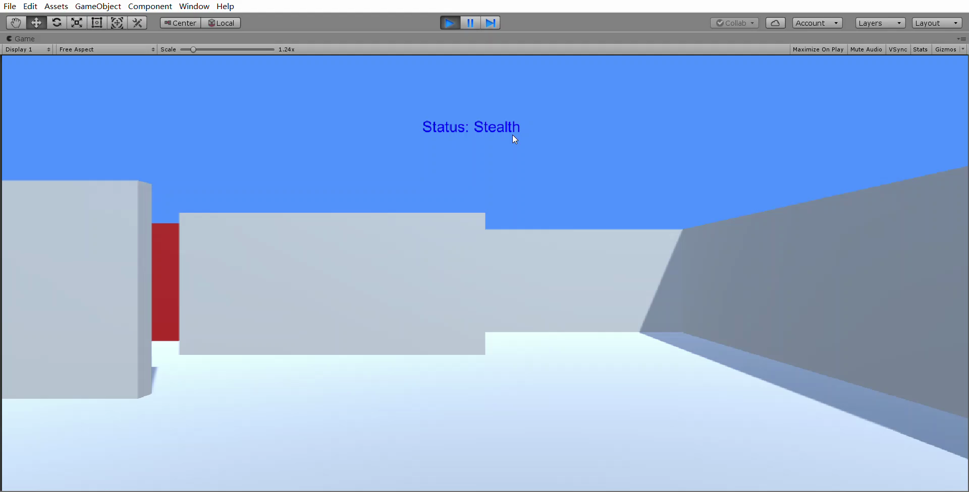
Demostration & Trained-AI Agent

Slide 49
Future Work
More features can be added in hide&escapee scenario,e.g. Sound system availiable for both agents
Combine different ML model while trainning e.g. LSTM

